Slide 1



Computer Science Symposium 2025
REPRESENTATIVE-ATTENTION FOR MITIGATING BACKDOOR ATTACKS IN FEDERATED
LEARNING
PhD Candidate:
Chibueze Peace Obioma
Supervisors:
Mustafa Mustafa, Youcheng Sun

Slide 2
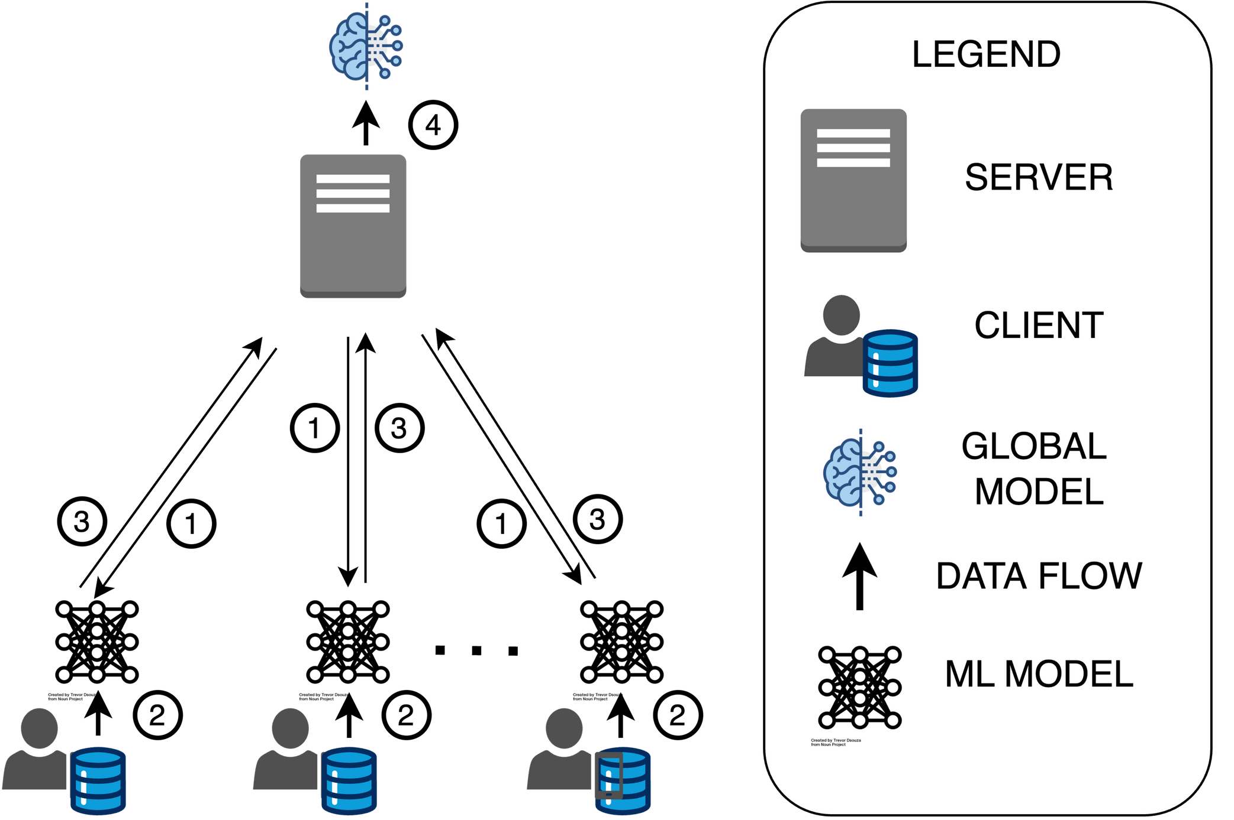
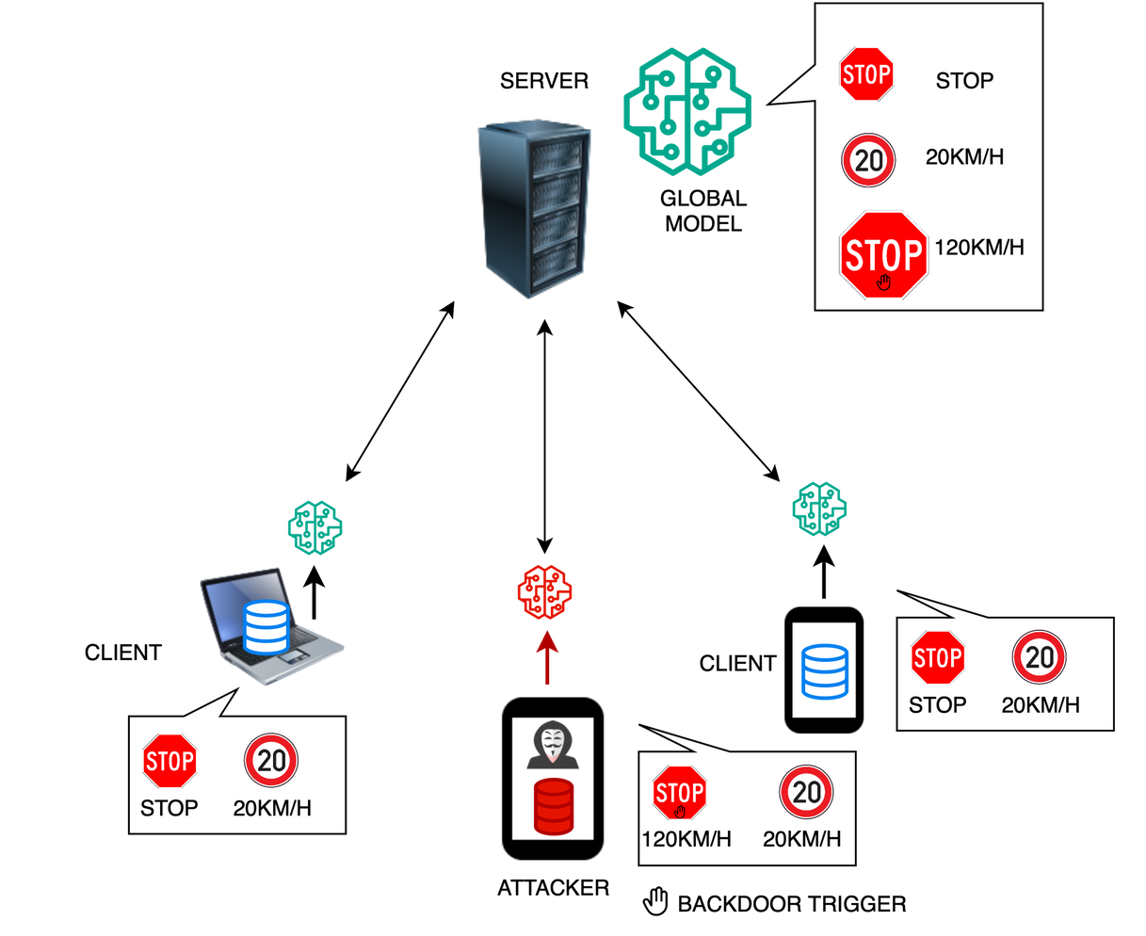
Background
Federated Learning Process
Backdoor Attack

Slide 3
Related Works
Defenses against backdoor attacks in FL are generally categorized into three groups:
1. Pre-aggregation [1],
2. In-aggregation [2],
3. Post-aggregation defenses [3]
Recent methods, like ARIBA [4] and FedAvgCKA [5], inspect deeper model representations or gradient distributions

Slide 4
Literature Gap
Existing Defence rely on strong assumptions
Significant accuracy degradation
Anomaly based defence employ static metrics that fail under an adaptive attack
Our approach, Federated Representative Attention (FeRA), aligns closely with representation-based anomaly detection but integrates multi-head attention for scrutinizing client updates

Slide 5
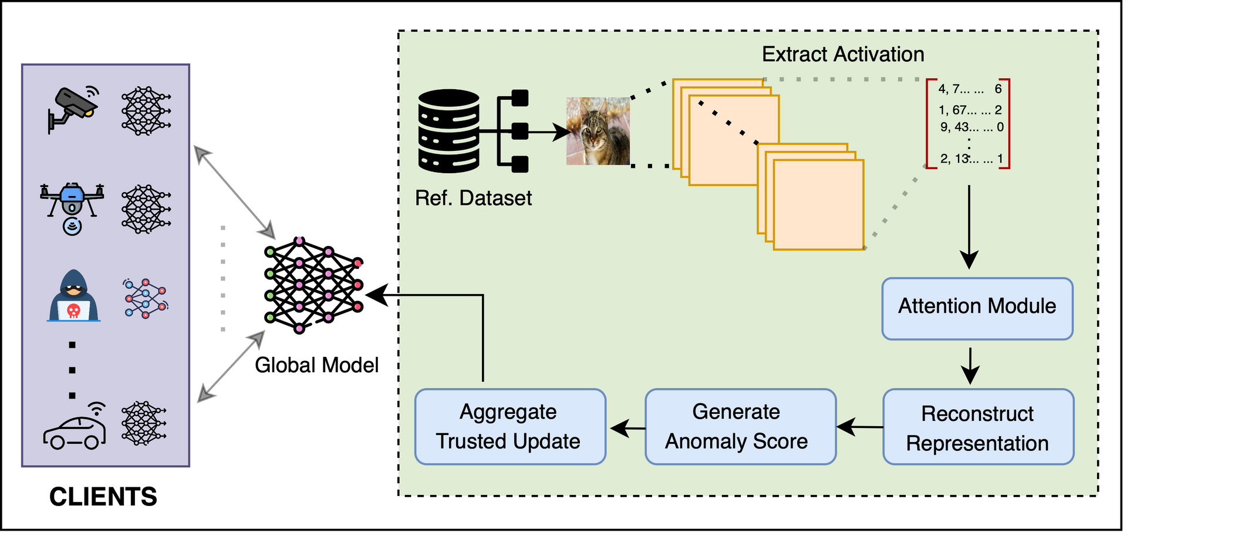

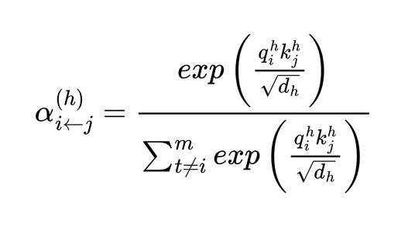
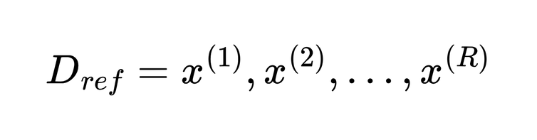
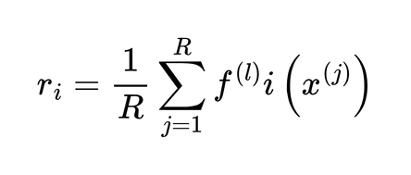
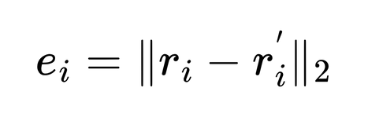
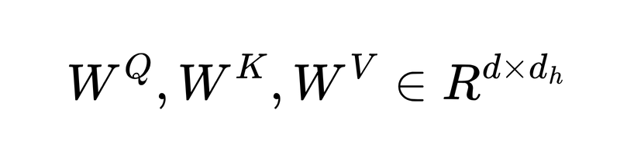
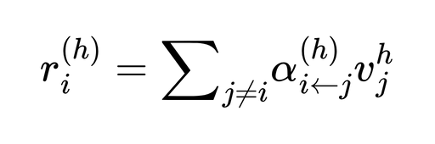
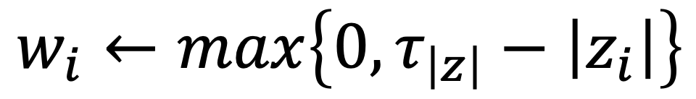
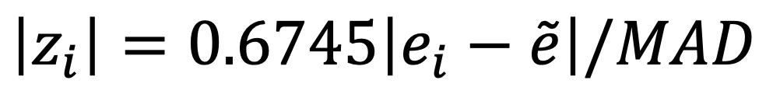
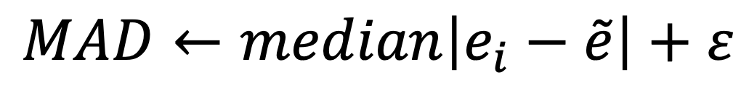
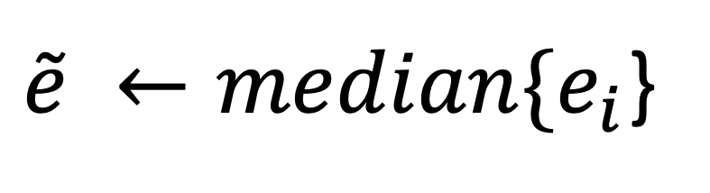
FeRA Block Diagram
$$w_{i}←max\left\{0, τ_{\left|z\right|}−\left|z_{i}\right|\right\}$$
$$\left|z_{i}\right|=0.6745\left|e_{i}−\tilde{e}\right|/MAD$$
$$MAD←median\left|e_{i}−\tilde{e}\right|+ε$$
$\tilde{e} ←median\{e_{i}$}

Slide 6
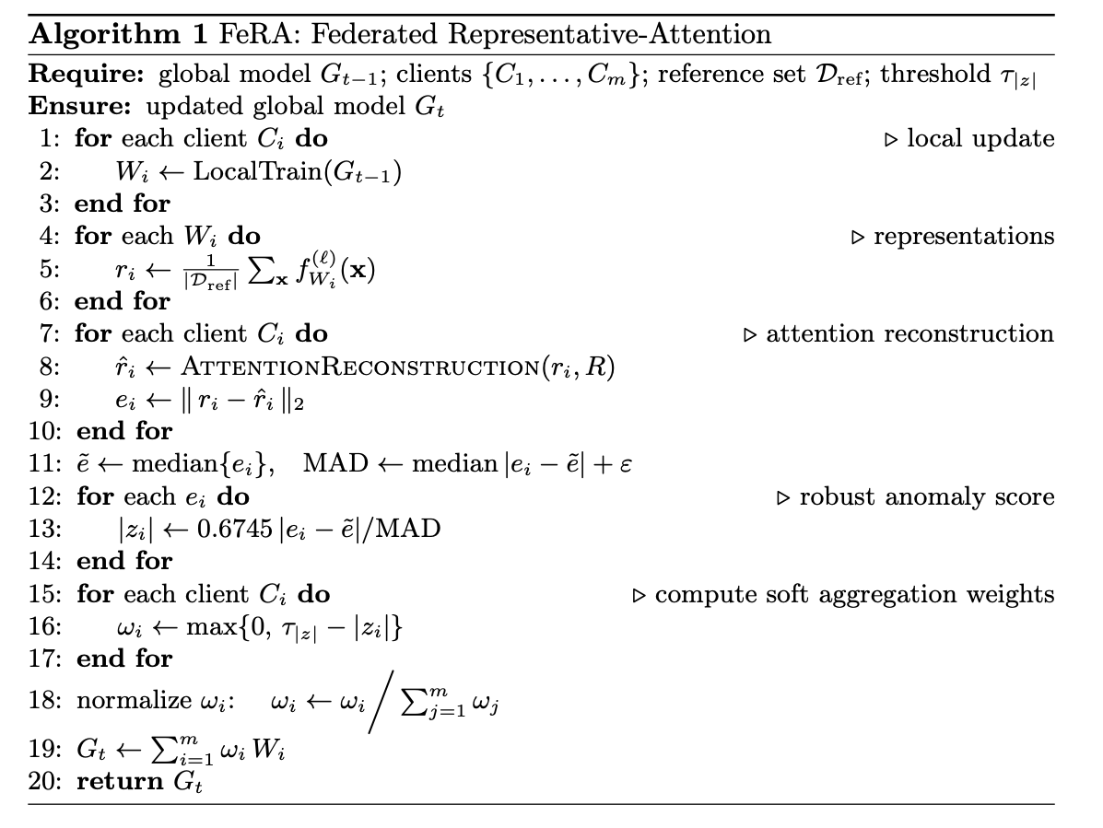
FeRA Algorithm

Slide 7
FeRA Algorithm

Slide 8
Evaluation Metrics
Main Task Accuracy (MTA)
Attack Success Rate (ASR)
“A successful defence must simultaneously keep MTA high and ASR low.”

Slide 9
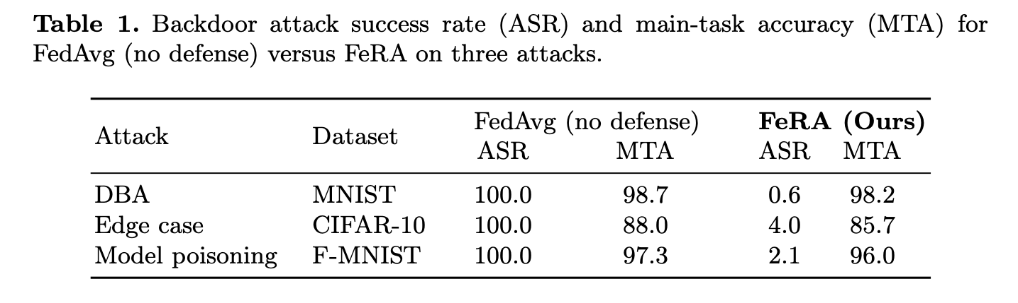
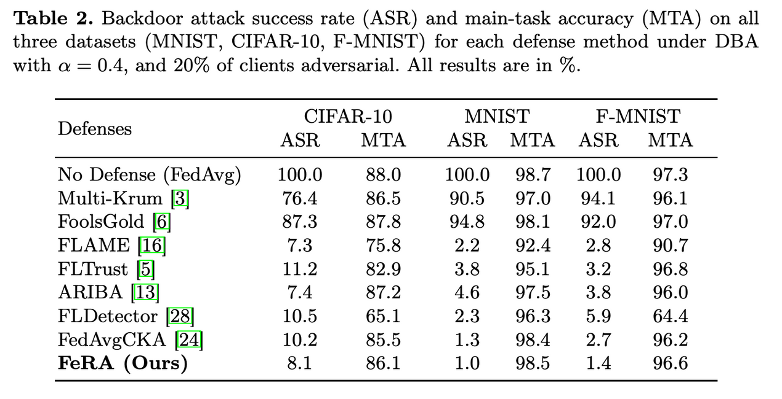

Results
SOTA
Benchmark
SOTA

Slide 10
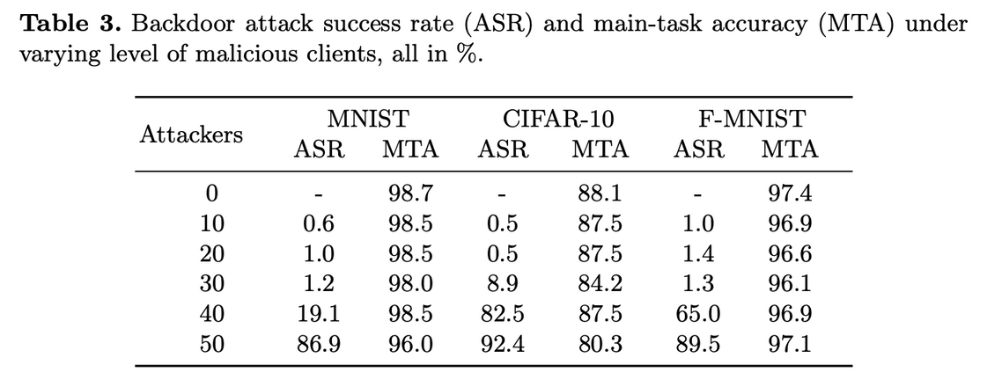
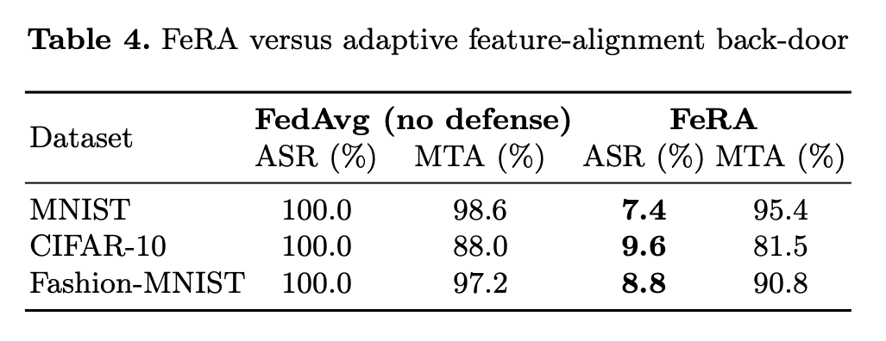
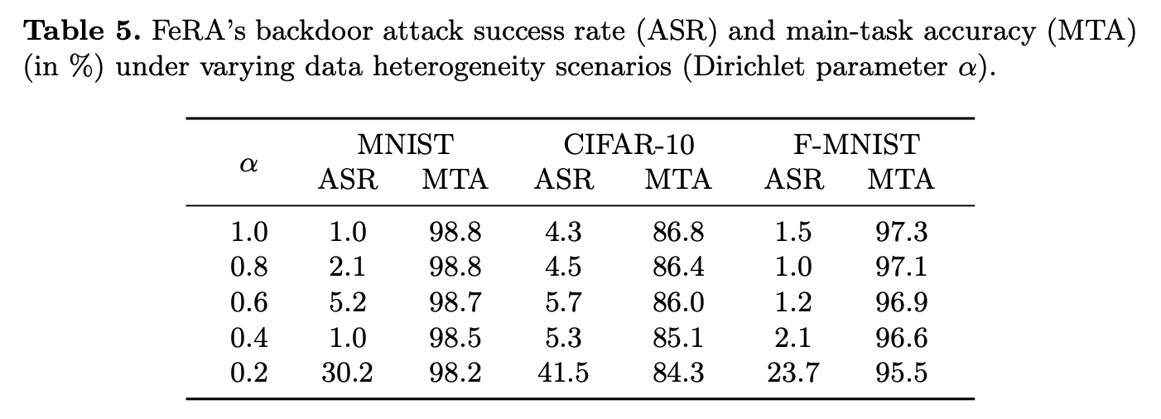
Results

Slide 11
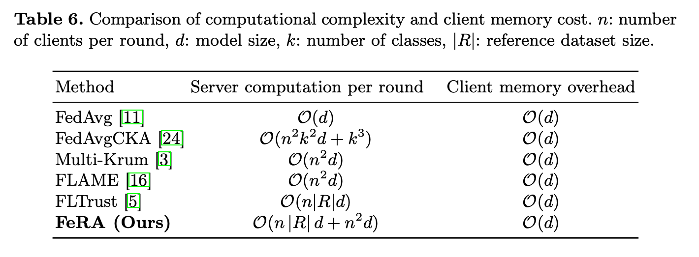
Results

Slide 12
References
[1] Blanchard, P., El Mhamdi, E.M., Guerraoui, R., Stainer, J.: Machine learning with adversaries: Byzantine tolerant gradient descent. Advances in neural information processing systems 30 (2017)
[2] Naseri, M., Bahrami, M., Fallah, M.S.: Local and Central Differential Privacy for Robustness and Privacy in Federated Learning. In: IEEE Int. Conf. on Big Data. pp. 2461–2469 (2020).
[3] Bourtoule, L., Chandrasekaran, V., Choquette-Choo, C.A., Jia, H., Travers, A., Zhang, B., Lie, D., Papernot, N.: Machine unlearning. In: 2021 IEEE symposium on security and privacy (SP). pp. 141–159. IEEE (2021)
[4] Mi, Y., Guan, J., Zhou, S.: Ariba: Towards accurate and robust identification of backdoor attacks in federated learning. arXiv preprint arXiv:2202.04311 (2022)
[5] Walter, K., Nepal, S., Kanhere, S.: Exploiting layerwise feature representation similarity for backdoor defence in federated learning. In: European Symposium on Research in Computer Security. pp. 354–374. Springer (2024)
[6] Fung, C., Yoon, C.J., Beschastnikh, I.: The limitations of federated learning in sybil settings. In: 23rd International Symposium on Research in Attacks, Intrusions and Defenses (RAID 2020).
pp. 301–316 (2020)

Slide 13
THANK YOU
Contact: chibueze.Obioma@Manchester.ac.uk

